Slide 1

Detection of Autism Spectrum Disorder in Children
Sanjukta Nad

Slide 2
Problem Statement
Autism Spectrum Disorder (ASD) is a neurological disorder which might have a lifelong impact on the language learning, speech, cognitive, and social skills.
Diagnosing ASD can be difficult because there is no medical test. Doctors look at the child’s developmental history and behavior to make a diagnosis.
To improve the precision and time required for diagnosis, machine learning techniques are being used to complement the conventional methods.
The main objective is to determine if the child is prone to ASD in its early stages, which would help streamline the diagnosis process.

Slide 3
Who might care?
Parents and guardians of children
Monitoring, screening, evaluating, and diagnosing children with ASD as early as possible is important to make sure children receive the services and supports, they need to reach their full potential.

Slide 4
Data information
Dataset used
https://www.kaggle.com/fabdelja/autism-screening-for-toddlers
Originally, the dataset had 1054 instances along with 18 attributes
Data Wrangling
non-contributing attributes, namely ‘Case_No’, ‘Who completed the test’, and ‘Qchat-10-Score’, those were dropped from the data set.

Slide 5
Data exploration
Dataset variable | Description
A1 | Child responding to you calling his/her name
A2 | Ease of getting eye contact from child
A3 | Child pointing to objects he/she wants
A4 | Child pointing to draw your attention to his/her interests
A5 | If the child shows pretense
A6 | Ease of child to follow where you point/look
A7 | If the child wants to comfort someone who is upset
A8 | Child’s first words
A9 | If the child uses basic gestures
A10 | If the child daydreams/stares at nothing
Features mapping with Q-CHAT-10 screening method
Ten behavioral features (Q-chat-10) plus other individuals characteristics were recorded that have proved to be effective in detecting the ASD cases from controls in behavior science.

Slide 6
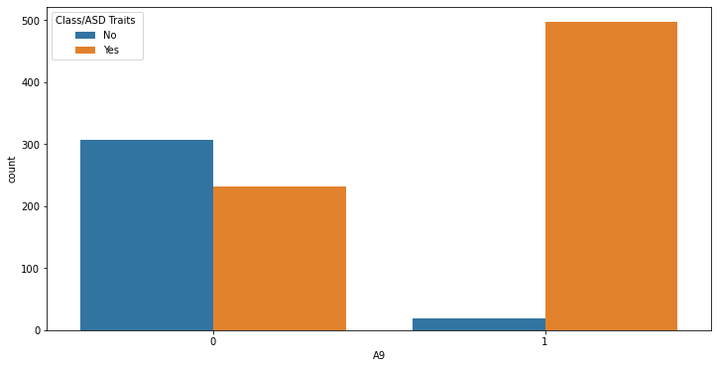
Data exploration
A9 has strong correlation with positive diagnosis.

Slide 7
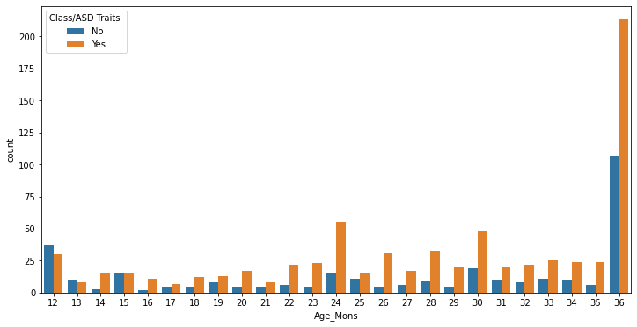
Data exploration
For toddlers, most of the ASD positive cases happen to be at are around 36 months of age.

Slide 8
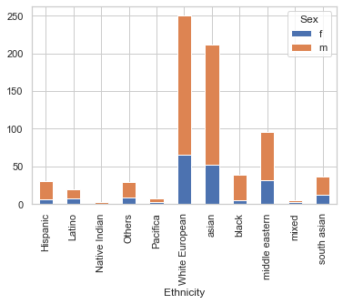
Data exploration
Middle eastern, Asian and White European are the ethnicities that showed an increase in autism cases

Slide 9
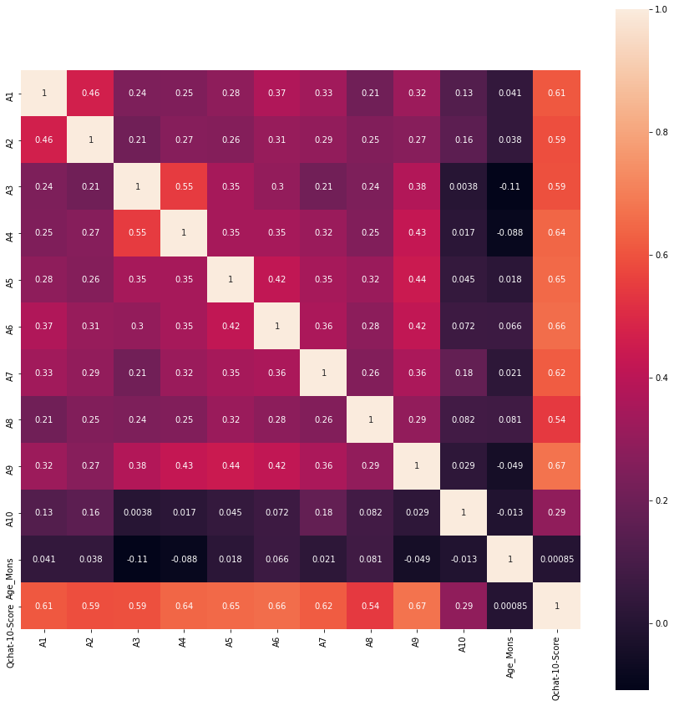
Correlation matrix shows A9, A7, A5, A6 has very strong correlation with Qchat-10- score

Slide 10
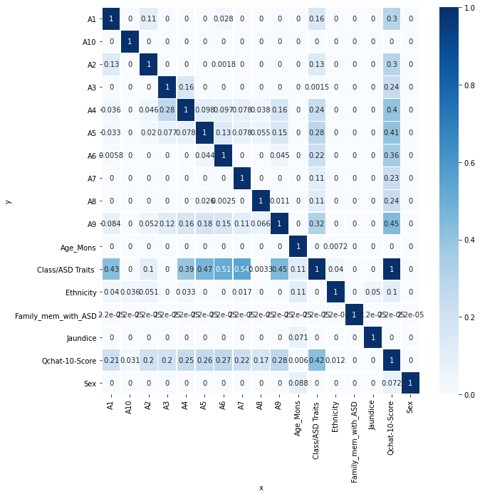
Predictive Power Score (PPS) matrix can also handle categorical and nominal, numerical values. PPS is asymmetric.
A7 PPS score on Class/ASD Traits is the highest (0.54), followed by A6 and A5.

Slide 11
Training and modelling
Four features having 2 classes (Sex, Jaundice, Family_mem_with_ASD, and Class/ASD_Traits) binary label encoding is used
For multiclass feature, ‘Ethnicity’ pandas get_dummies one hot encoder is used
The training set consisting of 70% of the data (737 samples) is used to train the classification model.
The remaining 30% of the data (317 samples) was reserved for testing the accuracy and effectiveness of the model on unseen data.

Slide 12
Training and modelling
A comparison of the applied ML models
 | LR | NB | SVM | KNN | RF
Accuracy | 100 % | 88.9 % | 81.7 % | 95.2 % | 96.2 %
Confusion matrix | [[ 95 0] [ 0 222]] | [[ 91 4] [31 191]] | [[37 58] [0 222]] | [[ 89 6] [ 9 213]] | [[ 86 9] [ 3 219]]
F1 score | 1.0 | 0.89 | 0.79 | 0.95 | 0.95

Slide 13
Training and modelling
Logistic Regression model testing accuracy was 100%. Logistic Regression with default parameters is an ideal model for this dataset.
Naïve Bayes model had test accuracy: 0.89 suggesting Naïve Bayes is a not a great model.
KNN model had test accuracy: 0.95 with best k = 20. Weight average Recall was 95% for positive cases, so KNN is good model.
SVM had low test accuracy: 0.81. It is not a good model for this dataset.
Random Forest model had test accuracy: 0.95 and weight average Recall = 99% for positive cases. After hypertuning Random Forest had performed even better with accuracy 0.96.

Slide 14
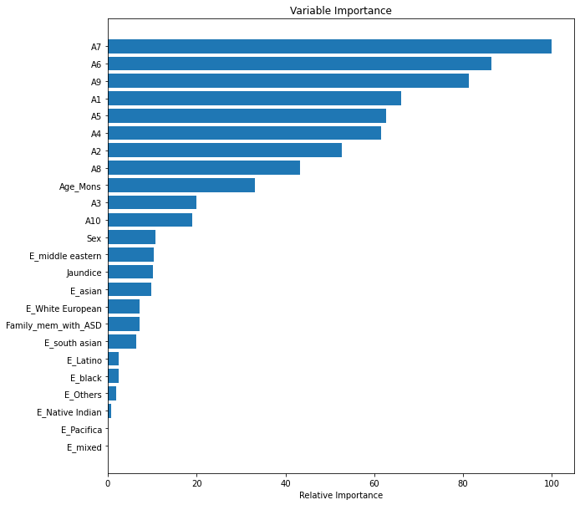
Variable importance
The variable importance plot reveals A7 is the most important features, other important features are A6, A9, and A1.

Slide 15
Summary and Conclusion
There is currently no diagnostic test that can quickly and accurately detect ASD, or an optimized and thorough screening tool that can clearly identify the onset of ASD.
This project has provided useful insights in the development of an automated model that can assist medical practitioners in detecting autism in children.
Out of the five models that I applied to the dataset; Logistic Regression was observed to give the highest accuracy.
The project analyzes different classification models that can accurately detect ASD in children with given attributes based on the child’s behavioral and medical information.
In future using a larger dataset if available will improve generalization.

